Slide 1
Lecture 10
Understanding Harmony in the Self
Part 1 – Introduction to Harmony in the Self
Part 2 – More details of the Self

Slide 2
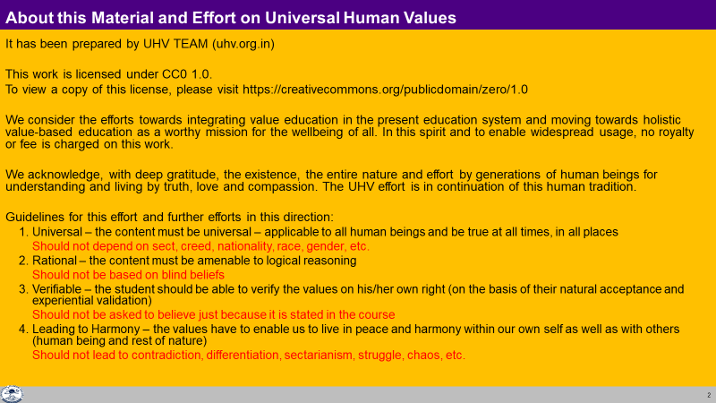

Slide 3
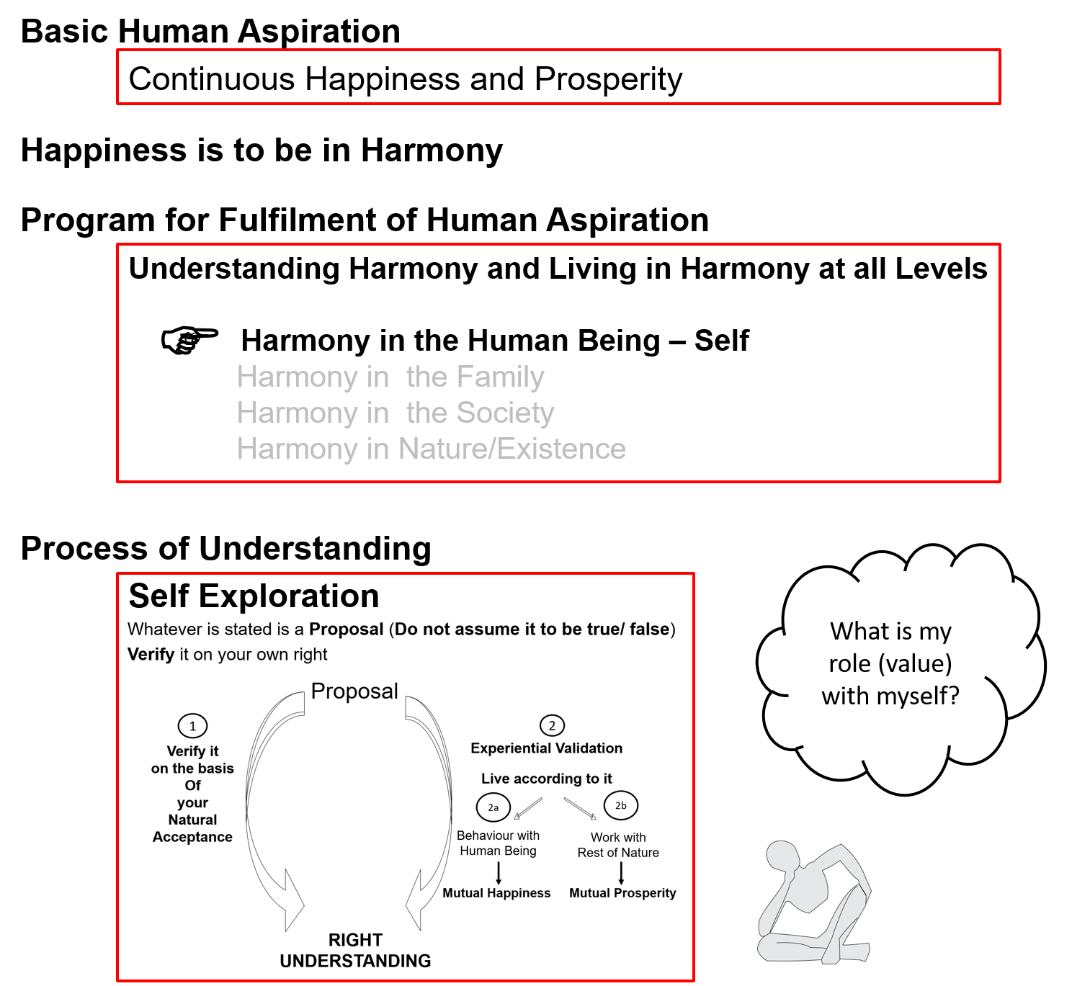

Slide 4
This presentation is in 2 parts
Part 1 – Introduction to Harmony in the Self
Part 2 – More details of the Self

Slide 5
Introduction to Harmony in the Self
Part 1 of 2

Slide 6
Human Being Ekkuo | Self eSa | Body “kjhj
Need vko';drk | Happiness (e.g. Respect) lq[k ¼tSls lEeku½ | Physical Facility (e.g. Food) lqfo/kk ¼tSls Hkkstu½
In Time dky esa | Continuous fujUrj | Temporary lkef;d
In Quantity ek=k esa | Qualitative (is Feeling) xq.kkRed ¼Hkko gS½ | Quantitative (Required in Limited Quantity) Ekk=kRed ¼lhfer ek=k esa½
Fulfilled By iwfrZ ds fy, | Right Understanding & Right Feeling lgh le>] lgh Hkko | Physio-chemical Things HkkSfrd&jklk;fud oLrq
Activity fØ;k | Imagination (Desire, Thought, Expectation)… bPNk] fopkj] vk”kk--- | Eating, Walking… [kkuk] pyuk---
In Time dky esa | Continuous fujUrj | Temporary lkef;d
Response | Knowing, Assuming, Recognising, Fulfilling tkuuk] ekuuk] igpkuuk] fuokZg djuk | Recognising, Fulfilling igpkuuk] fuokZg djuk
 | Consciousness pSrU; | Material tM+
Co-existence
lgvfLrRo

Slide 7

Recalling: Activities of the Self
Natural Acceptance
To be happy
To be prosperous
To have health in the body
To have the feeling of relationship
Dialogue?
Self
Imagination
I expect to be respected…
I think I am special…
I desire to be a billionaire…
I feel like taking revenge…
Co-existence
Body
Behaviour O;ogkj
Work dk;Z
Notes:
The Self can be recognized in terms of its activity
We can see the activity of imagination… try it now – what is going on? All the time or only sometimes (keep it open)?
Reinforce - Behaviour and work are only expressions of imagination
Every Self has a natural acceptance
(E.g., We have a natural acceptance for the feeling of relationship… not for opposition)
The natural acceptance is a glimpse of the higher possibility in the Self, a glimpse of what I really want to be
Natural acceptance is definite, uncorrupted, universal…
5. The dialog that we started between me and you will soon begin within you – a dialogue beween your imagination and your natural acceptance

Slide 8
Recalling: Dialogue Within
INTENTION
What I really
want to be
Intended State
Natural Acceptance
Feeling of
Relationship
Dialogue?
Guiding?
Contradiction
Unhappiness
Harmony
Happiness
COMPETENCE
What I am
Current State
Imagination
Feeling of
Opposition
Feeling of
Relationship
Notes:
The dialogue within is the dialogue between my imagination and my natural acceptance
Between my competence and my intention
Between “what I am” and “what I really want to be”
The natural acceptance is always for relationship
My imagination may or may not always be for relationship! Sometimes it is for opposition!
Now whenever my imagination is in harmony with my natural acceptance, I am in a state of happiness!
Whenever my imagination is in contradiction with my natural acceptance, I am in a state of unhappiness!
So to be in harmony, all I have to do is to
Be aware of my natural acceptance
Be aware of my imagination
Ensure the dialogue and ensure that my imagination is in line with my natural acceptance

Slide 9
Activities of the Self eSa dh fdz;k,a
1.
2.
3. | Desire bPNk
4. | Thought fopkj
5. | Expectation vk'kk
Activity fØz;k
Imaging fp=.k
Analysing-Comparing fo'ys"k.k&rqyu
Selecting-Tasting p;u&vkLoknu
Self eSa
Natural Acceptance
Imagination
dYiuk”khyrk
Imagination
(Desire, Thought, Expectation)
Information
Body 'kjhj
Behaviour O;ogkj
Work dk;Z
Notes:
The Self can be recognized in terms of its activity
We can see the activity of imagination – our (desire, thought, expectation)
Reinforce - Behaviour and work are only expressions of imagination - the Self instructs the Body and it does
The only transaction between the Self and the Body is in the form of information
We can observe our imagination – try it now – what is going on?

Slide 10


Sources of Motivation for our Imagination and its Implications
1.
2.
3. | Desire bPNk
4. | Thought fopkj
5. | Expectation vk'kk
Activity fØz;k
Imaging fp=.k
Analysing-Comparing fo'ys"k.k&rqyu
Selecting-Tasting p;u&vkLoknu
Self verification on the basis of Natural Acceptance
lgt Loh—fr ds vk/kkj ij tkap dj
Self eSa
3
Self-organised
Lora=rk √
Preconditioning
ekU;rk
Content of Imagination
dYiuk”khyrk
dh oLrq
1
Enslavement
ijra=rk X
Information
Body 'kjhj
2
Sensation
laosnuk
Behaviour O;ogkj
Work dk;Z
Enslavement ijra=rk X
Notes:
Imagination may be motivated by sensation, preconditioning or NA (these are 3 possible sources of motivation for imagination)
Give small examples of each source of motivation
We will discuss the Activities in detail in the next section. Do not get into that here

Slide 11
Example: Preconditioning, Sensation and Natural Acceptance
Food for taste
Food for health
Food for show off
Sensation
Natural Acceptance
Preconditioning

Slide 12
Preconditioning, Sensation and Natural Acceptance
Preconditioning: Assuming without knowing
Not definite | Keeps changing with time, place, individual | Enslavement
Sensation: Information through sense organs (Sound, Touch, Sight, Taste, Smell) from outside, through the body
  Not definite | Keeps changing with time, place, individual | Enslavement
  When we try to derive happiness from sensation, the following sequence applies
  tasty-necessary → tasty-unnecessary → tasteless-unnecessary → intolerable
Natural Acceptance: What I really want to be, intention
Definite | Continuous | Universal | Self-organisation
Leads to harmony (happiness) within
  We have a natural acceptance for:
    Relationship [of mutual fulfillment, complimentarity, not for opposition]
    Harmony [mutual enrichment, not for exploitation, harmony within, and harmony outside]
    Co-existence [not for struggle, conflict]
Notes:
In UHV-Intro, keep the discussion on this very brief. Give small examples
In UHV-II, there can be a bit more elaboration

Slide 13
Exercise: Preconditioning, Sensation or Natural Acceptance?
Respect elders
To win
Want to make the other happy
Healthy Body
To be special, unique
To come first in the class
Feeling of collaboration
…
Preconditioning
Feeling of respect for all
To get a good name
There is struggle for survival
survival of the fittest
Want the Body to look good
I want that bike… because
I like its colour, its shape…
To understand everything
Feeling of competition
Natural Acceptance
Preconditioning
Preconditioning
Natural Acceptance
Preconditioning
Natural Acceptance
Sensation
Preconditioning
Sensation
Preconditioning
Natural Acceptance
Natural Acceptance
Preconditioning

Slide 14
Imagination not completely in line with Natural Acceptance → Partial harmony in the Self
 |  | Activity fØz;k
1.
2.
3. | Desire bPNk | Imaging fp=.k
4. | Thought fopkj | Analysing fo'ys"k.k
5. | Expectation vk'kk | Selecting/Tasting p;u@vkLoknu
Self verification on the basis of Natural Acceptance
lgt Loh—fr ds vk/kkj ij tkap dj
3
Self-organised
Lora=rk √
Preconditioning
ekU;rk
1
Harmony?
Contradiction?
Information
Body 'kjhj
2
Sensation
Lakosnuk
Behaviour O;ogkj
Work dk;Z
Notes:
Generally, all three sources motivate my imagination
The yellow part is my competence – that matches with my NA (my intention); the rest may or may not match

Slide 15
Imagination fully in line with Natural Acceptance → Harmony in the Self
 |  | Activity fØz;k
1.
2.
3. | Desire bPNk | Imaging fp=.k
4. | Thought fopkj | Analysing fo'ys"k.k
5. | Expectation vk'kk | Selecting/Tasting p;u@vkLoknu
Right Understanding
in the Self
Natural Acceptance
INTENTION
What I Really Want to Be
Guiding
Content of imagination
In harmony
COMPETENCE
What I Am
Information
Body 'kjhj
Behaviour O;ogkj
Work dk;Z
Happiness = To be in a state of Harmony
Lkq[k ¾ laxhr esa] O;oLFkk esa thuk

Slide 16
Current State of the Self
Self verification on the basis of Natural Acceptance
lgt Loh—fr ds vk/kkj ij tkap dj
3
Preconditioning
ekU;rk
1
Enslavement
ijra=rk X
Self-organised
Lora=rk √
2
Sensation laosnuk
Enslavement ijra=rk X
Notes:
We are not sure if the imagination motivated by preconditioning and sensation is going to be in harmony or contradiction with our natural acceptance

Slide 17
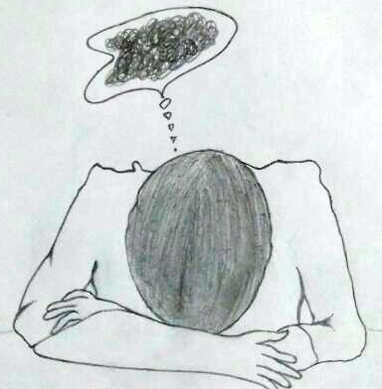
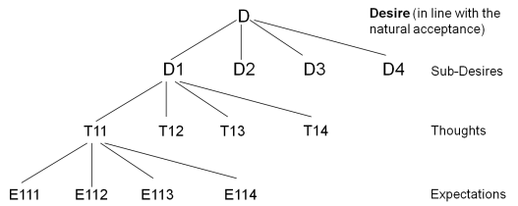
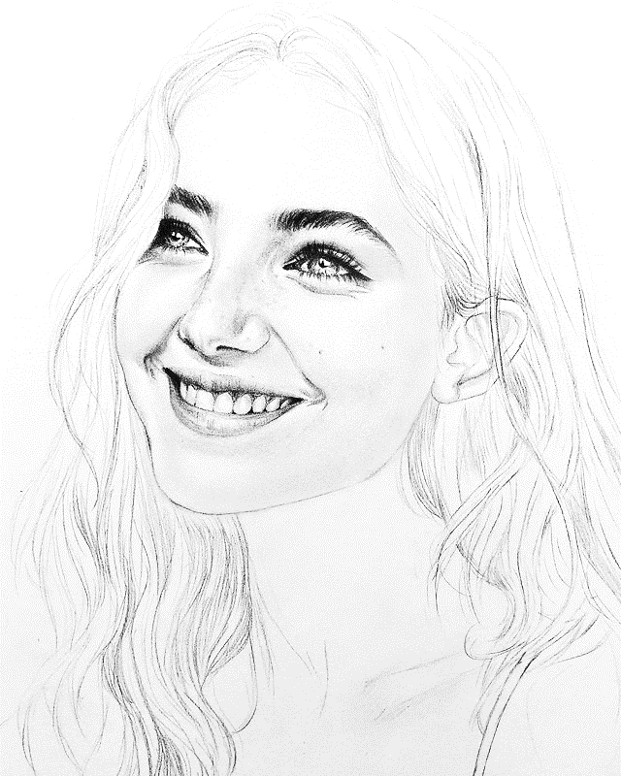
Self in Disharmony – Unhappy Self Self in Harmony – Happy Self
Imagination partially guided by natural acceptance
Developed Self: Imagination fully guided by
natural acceptance, right understanding

Slide 18
Self Reflection

Slide 19
Sources of Motivation for our Imagination and its Implications
 | Power ”kfDr
1.
2.
3. | Desire bPNk
4. | Thought fopkj
5. | Expectation vk'kk
Activity fØz;k
Imaging fp=.k
Analysing-Comparing fo'ys"k.k&rqyu
Selecting-Tasting p;u&vkLoknu
Self eSa
Content of Imagination
dYiuk”khyrk
dh oLrq
Information
Body 'kjhj
Behaviour O;ogkj
Work dk;Z
Notes:
Imagination may be motivated by sensation, preconditioning or NA (these are 3 possible sources of motivation for imagination)
Give small examples of each source of motivation

Slide 20
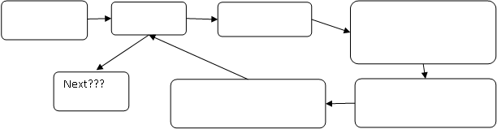
Practice Session : Be aware of Your Imagination, Check if you are aware all the time…
Observe your imagination for at least 5 minutes
List down the object of your imagination at least once every minute. From this list or from directly observing your imagination, make a sequence diagram (as shown below).
Now write down your observations:
  Are you able to see your imagination all of the time or only some of the time?
  If you are able to see (be aware of) your imagination only some of the time, what do you think is the reason?
  Are all your imaginations well connected (one imagination leads logically to another imagination) or are there sudden changes from one subject to another subject or there are gaps in between one imagination and another imagination? What is the reason for this state of imagination?

Slide 21
PS (cont.): Be aware of Your Imagination, Check if it is in harmony or contradiction
Is the imagination for relationship or opposition?
Is the imagination for harmony or struggle, exploitation?
Is the imagination in line with (in harmony with) your natural acceptance?
Are the various imaginations in harmony or contradiction with each other?
What is the motivation for each imagination? (preconditioning? sensation? natural acceptance?)

Slide 22
Activities of the Self in More Detail
Part 2 of 2

Slide 23
Activities of Self eSa dh fdz;k,a
 | Power “kfDr
1.
2.
3. | Desire bPNk
4. | Thought fopkj
5. | Expectation vk'kk
Activity fØz;k
Imaging fp=.k
Analysing-Comparing fo'ys"k.k&rqyu
Selecting-Tasting p;u&vkLoknu
IMAGING a happy and prosperous life (what I want to be)
ANALYSING how to go about it COMPARING various options
SELECTING an option with a TASTE stated within (what to get, to do)
Self eSa
Information
Body 'kjhj
Imagination
dYiuk”khyrk
Behaviour O;ogkj
Work dk;Z
Note: We explore these and other higher activities of the Self in detail in UHV-III

Slide 24
Example
To be a person with a good status in society

Slide 25
Exercise: Desire or Expectation?
a big house
Want others to like me, pay attention to me
Name, fame…
Pleasures…
Freedom…
Degree
Knowledge…
Job
Money
World tour
Family

Slide 26
Exercise: Desire or Expectation?
Big house
(expect a big house) E
(want to be the owner of a big house) D
Want others to like me, pay attention to me E
Name, fame… E
Pleasures… E
Freedom…
(self-organization, swatantrata) D
(manmani) E
Degree E
Knowledge…
(right understanding) D
Job E
Money E
World tour E
Family E

Slide 27
Recalling: Source of Motivations for our Desires - Its Implications
 | Power “kfDr
1.
2.
3. | Desire bPNk
4. | Thought fopkj
5. | Expectation vk'kk
Activity fØz;k
Imaging fp=.k
Analysing-Comparing fo'ys"k.k&rqyu
Selecting-Tasting p;u&vkLoknu
Self verification on the basis of Natural Acceptance
lgt Loh—fr ds vk/kkj ij tkap dj
Self eSa
3
Preconditioning
ekU;rk
Self-organised
Lora=rk √
1
Enslavement
ijra=rk X
Imagination
dYiuk”khyrk
Information
Body 'kjhj
2
Sensation
laosnuk
Behaviour O;ogkj
Work dk;Z
Enslavement ijra=rk X

Slide 28
Exercise: Check if Your Desires, Thoughts and Expectations are in Harmony
Desires, feelings are clear, and are naturally acceptable
Thoughts are about how to fulfill desires
These thoughts give rise to definite expectations
These D, T, E are in harmony…
Desires, feelings are not clear, may not be naturally acceptable
Expectations, based on preconditioning and sensation, are predominant
Thoughts are about how to fulfil expectations
These thoughts give rise to more such expectations
These D, T, E are largely in contradiction
Natural Acceptance
Preconditioning
Sensation
Natural Acc.
D1 D2 Dn
T₁₁, T_{12 ….}T_{1n} T₂₁, T₂₂,…T_{2n} T₃₁, T₃₂,..T_{3n}
E₁₁₁, E₁₁₂ ,.. E_{1n} E₂₁, E₂₂,.. E_{2n}
E1 E2 …En …..D1
T₁₁, T_{12 ….}T_{1n} T₂₁, T₂₂,…T_{2n} T₃₁, T₃₂,..T_{3n}
E₁₁₁, E₁₁₂ ,.. E_{1n} E₂₁, E₂₂,.. E_{2n}

Slide 29
Self in Disharmony – Unhappy Self Self in Harmony – Happy Self
Imagination partially guided by natural acceptance
Developed Self: Imagination fully guided by
natural acceptance, right understanding

Slide 30
Sum Up
Imagination, which consists of desire, thought and expectation, is continuously going on in the Self
Behaviour, work are an expression of the imagination
The imagination represents our present state of being, our competence
The faculty of natural acceptance is always there in every self
It is innate, uncorrupted by preconditioning, universal (same for all)
Natural acceptance indicates “what we really want to be”, this is our intention
We have a natural acceptance for harmony…
The Self is in harmony when the imagination is in line with the natural acceptance
(and therefore, there are no contradictions in the Self)
Continued next page…

Slide 31
Sum Up (cont.)
Imagination may be motivated by preconditioning, sensation or natural acceptance
When imagination is fully motivated by natural acceptance, the Self is in harmony; and therefore in a state of continuous happiness.
  This is the state of self-organization (स्वतंत्रता)
  This is my "intention", my "desired state", "what I really want to be"
  In this state, the conduct is definite and human
When the imagination is motivated by preconditioning or sensation, the Self may be in harmony or disharmony/contradiction; and thus in a state of happiness or unhappiness.
  The state of the self is largely dictated by external influences
  This is a state of enslavement (परतंत्रता)
  This is my present "competence", my "present state", "what I am"
  In this state, the conduct is indefinite (it may be human or inhuman)

Slide 32
Self Reflection

Slide 33
Practice Session: Your Desire, Thought and Expectation
Be aware of your imagination, be aware of your desire, thought and expectation
Check:
  Is it a desire? (feeling?)
  Is it a thought? (analysing? comparing?)
  Is it an expectation? (selecting? tasting?)
  Is the thought primarily about analysing
    ‘what I want to be’
    or
    ‘what I want to get or what I want to do’
Is your desire, the feeling that you have, naturally acceptable to you?

Slide 34
Practice Session: Source of Motivation for your Desires
Take your list of imagination. Revise it if you need to. Identify the desire for each imagination
For each desire, identify the primary source of motivation (sensation, preconditioning or natural acceptance). If there is any desire which has more than one source of motivation, split it into two or more desires. E.g. a desire for good clothes may be motivated by your natural acceptance (to protect the Body from excessive heat or cold) and also be motivated by the social preconditioning for the clothes of the latest fashion. In such a case, split the desire into two desires.
Now, write down your observations:
  What percentage (approximately) of your desires is motivated by your natural acceptance? This will give you an idea of the percentage that you are self-organised. Keep in mind that natural acceptance is about purpose and it does not change with time, place or person.
  What percentage (approximately) of your desires is motivated by sensation or preconditioning? Now you can get an idea of the percentage that you are dependent or enslaved.
  What effort is necessary to be completely self-organised (if that is your goal)?

Slide 35
FAQs for Lecture 10
Understanding Harmony in the Self

Slide 36
Activities of the Self
Desire or feeling E.g., “I want to be happy”, “I want to be the owner of a big house”
E.g., “feeling of respect”, “feeling of jealousy”
Imaging = “what I want to be”, its details
Thought = how to ensure the desire “what I want to be” or
how to ensure the expectation “what I want to get”
Analysing = detailing, dividing into smaller parts, generating options
Comparing between the options based on criteria that maximises my happiness
Expectation of “what I want to get”
(from outside the Self – physical facility, sensation or feeling from other)
Selecting = choosing an input from outside or an expression for outside
Tasting what has been selected, matching the taste with the expected taste
Note: We explore these activities in detail in UHV-III

Slide 37
Question(s): What is Self Response
Is Self the same as the mind or the soul?
Isn’t what is being said here the same as spirituality?
The mind is a part of the Self. The activity of imagination which includes activities of desire, thought and expectation if referred to as mind. Soul has been used in different ways, sometime it is used to represent the highest activity of the self while in many cases it is used to mean self as a whole.
We are trying to work for a system of education that makes us human. So, we are talking about humanness- what is being human.
Because human being is coexistence of self (consciousness) and body (material), hence, we have to understand the laws of material as well as the laws of consciousness. This is what we are trying to do.

Slide 38
Word
Meaning
(a description of some part of the reality)
Reality

Slide 39
Question(s): Activities of the Self Response
I do think sometimes but not all the time. Like when I am asleep, I do not think. So, why do we say activities of Self are continuous?
Most of the time, we are not able to remember what is going on in our imagination. Is there some practice, like meditation, to become aware of it?
Do you dream while sleeping? Does dream include thinking? Now,, try to be aware of your imagination when you are awake, then slowly you can be aware of your imagination even when you are asleep, then you will be able to verify whether you are thinking while sleeping or not.
One simple way to be aware of your self, be aware of the imagination going on in the self at this moment of time. If you are aware, it will be there in your remembrance. When you pay attention to your imagination, you are able to see it, because you already have the potential to see, you only have to exercise this potential ,

Slide 40
We all have the capacity to pay attention, to observe… to understand
You are already paying attention… to whatever you consider important
So, the main question is not “how to pay attention”, rather it is “what to pay attention to”
(object of attention)
One only has to see, to decide that:
I am important, Self is important
My imagination is important
Then I will pay attention to the Self and my imagination

Slide 41
Science of material
- You can look at it outside, you may not be
Science of consciousness
You are part of it, you want to and do get transformed

Slide 42
Question(s): Activities of the Self Response
What is the need to see these activities separately? How can we differentiate between desire and thought and expectation? It all seems to be one thing
If you do not observe things with fineness, everything seems to one gross thing. However, when you look at it with subtleness, you see that it is composed of many things. Like that, imagination is composed of three different levels of activities of the self- desire, thought and expectation. As explained, desire relates to our purpose, what we want to be, our feelings, while thought is working out the details of how to fulfill this purpose and expectation is what I need to do with the world outside. Desire is at the base of thought and expectation, so, if we have to evaluate our imagination and set it right, it has to be done at the level of desire, the feeling; and this desire, this feeling can be easily verified with our natural acceptance.

Slide 43
Activities of Self eSa dh fdz;k,a
 | Power “kfDr
1.
2.
3. | Desire bPNk
4. | Thought fopkj
5. | Expectation vk'kk
Activity fØz;k
Imaging fp=.k
Analysing-Comparing fo'ys"k.k&rqyu
Selecting-Tasting p;u&vkLoknu
Meaning
What I want to be My feeling within
How to go about it How to ensure fulfillment of the feeling (its details)
What I have to do outside for expression of the feeling
Self eSa
Information
Body 'kjhj
Imagination
dYiuk”khyrk
Note: We explore these activities in detail in UHV-III

Slide 44
Pure Self: Imagination on basis of Realisation, Understanding & Contemplation
Space “kwU;
 | Power “kfDr | Dynamic Activity xfr fØz;k | State Activity fLFkfr fØz;k
1. |  | Authentication Áek.k | Realization vuqHko | Co-existence lg&vfLrRo
2. |  | Determination ladYi | Understanding cks/k | Harmony in Nature O;oLFkk
3. | Desire bPNk | Imaging fp=.k | Contemplation fparu | Participation in Larger Order, Relationship O;oLFkk esa Hkkxhnkjh
4. | Thought fopkj | Analysing fo'ys"k.k | Comparing rqyu | Co-existence, Harmony, Justice Guided Senses, Consumption, Profit
5. | Expectation vk'kk | Selecting p;u | Tasting vkLoknu | Goal, Value Guided Sensation
B1
Self
eSa
B2
Body 'kjhj
Behaviour O;ogkj
Human ekuo
Work dk;Z
Rest of Nature
euq";srj iz—fr
Participation Òkxhnkjh
in larger Order O;oLFkk esa
Other nwljk
Note: We explore these activities in detail in UHV-III

Slide 45
Deluded Self: Imagination on basis of Sensation & Preconditioning
  Self verification on the basis of Natural Acceptance
lgt Loh—fr ds vkËkkj ij tkap dj
 | Power “kfDr | Dynamic Activity xfr fØz;k | State Activity fLFkfr fØz;k
1. |  | Authentication Áek.k | Realization vuqHko
2. |  | Determination ladYi | Understanding cks/k
3. | Desire bPNk | Imaging fp=.k | Contemplation fparu
4. | Thought fopkj | Analysing fo'ys"k.k | Comparing rqyu | Unguided Senses, Consumption, Profit
5. | Expectation vk'kk | Selecting p;u | Tasting vkLoknu | Unguided Sensation
B1
3
Self
eSa
Preconditioning
ekU;rk
1
B2
Body 'kjhj
2
Sensation
Lakosnuk
Behaviour O;ogkj
Human ekuo
Work dk;Z
Rest of Nature
euq";srj iz—fr
Other nwljk
Note: We explore these activities in detail in UHV-III

Slide 46
Question(s): Activities of the Self Response
What is the difference between deciding and selecting? They seem same to me
What is in activity 1 & 2? Why is it kept blank?
Deciding is working out the details of how to fulfill the purpose, the desire; whereas selecting has to do with what to do at the level of world outside. For example, if I have feeling of respect, then this is my desire, now, when work out the details of how to express this feeling of respect, by giving blessing, touching feet, greeting with some gift etc., it is a thought ; when this greeting is to be done with a flower bouque, it is expectation.
We will talk about these higher activities in detail in later course UHV III; however, we will very briefly introduce the activities of realisation and understanding as 1 and 2 towards the end of the session.

Slide 47
Question(s): Activities of the Self Response
Isn’t desire and intention the same?
What is the meaning of competence? Is it the skill?
Intention has to do with the feeling which is in accordance with natural acceptance, hence is definite, while desire could any feeling, in accordance or against the natural acceptance, hence is definite. For example, intention will always be for feeling of respect while desire could be for feeling of respect or disrespect.
The word competence is used to represent what is our state at the level of imagination-what is our desire, thought and expectation, as that will decide our behaviour with world outside as well.
The more our imagination is in harmony, the more competent we are

Slide 48

State of Imagination – Random and Disorganised
 | Force / Power cy@“kfDr | Activity fØz;k
1. |  | Realization vuqHko
2. |  | Understanding cks/k
3. | Desire bPNk | Imaging fp=.k
4. | Thought fopkj | Analysing fo'ys"k.k
5. | Expectation vk'kk | Selecting/Tasting p;u@vkLoknu
Natural Acceptance
INTENTION
3
Preconditioning
ekU;rk
1
COMPETENCE
What You Are
Information
Body 'kjhj
2
Sensation
Lakosnuk
Behaviour O;ogkj
Work dk;Z

Slide 49
Question(s): Activities of the Self Response
Can you tell us something about the conscious, subconscious and super conscious mind
The sense in which these words are used in general is the following-
when we are aware of what is going on in the self, it is being conscious,
when we are not aware of what is going on in the self, it is being subconscious,
when we are operating with higher activities of the self, like realisation and understanding, it is called super conscious,
Unconscious – not aware of the world outside
Freud:
id selecting-tasting
Ego imagination based on preconditioning “I am separate from the other, in isolation”
Super ego superconscious

Slide 50
Question(s): Preconditioning Response
What is preconditioning? “resources are limited, Desires are unlimited” is that a preconditioning or reality?
(it implies that everyone is bound to be deprived!
Preconditioning is something which is prevailing in the society which we have accepted without verification or without knowing. We are dictated by the world outside. A preconditioning may or may not correspond to a reality.
As far as this particular preconditioning is concerned, it does not correspond to a reality because
Desires, if we understand properly, are definite i.e., continuity of happiness and prosperity and the amount of physical facility required for ensuring prosperity is limited and can be identified.
Availability of resources in nature and capacity to produce in human being is more than what is required.

Slide 51
Desires are definite
Resources are limited, but more than our needs
Therefore, everyone can be prosperous)
Need to study
Science of material (the world outside) – I am what I am, I don’t have to change
Science of consciousness (the world within) – I have to see myself… then I am motivated to develop, to transform to human consciousness

Slide 52
Question(s): Conditioning Response
Pavlov has a theory of conditioning. How does it apply to us?
If we identify ourselves as the body and therefore, if the self is influenced by the body then Pavlov theory of conditioning will hold good. However, if we can understand the self and body separately and the self has right understanding and right feeling, than self is in a self-organised state and it responds to any input from the body, and not react. Therefore, its response to the input from the body will depend upon what self finds appropriate for maintaining the health of the body rather than the conditioning which is tried to be created through the conditioning input.
Self can even articulate that some conditioning is being created and therefore, he will be out of conditioning.

Slide 53
Question(s): Motivation of Imagination Response
What exactly is natural acceptance? Is it same as right understanding?
How can I be sure that my imagination is motivated by my natural acceptance?
Natural acceptance is something which is part of our being. It is innate, invariant, and uncorrupted by the preconditioning for ex. we have natural acceptance for the feeling of relationship, feeling of nurturing the body. It is the answer that we get from our conscience or the inner voice or the pure observer which is innermost part of the self.
Right understanding is understanding the reality as it is, and this can be ensured through the process of self-exploration based on natural acceptance and experiential validation.
If my imagination is in accordance with my natural acceptance, then I am in state of harmony within, happiness within. If not, then I am in contradiction within, unhappiness within.

Slide 54
Question(s): Motivation of Imagination Response
The exercise on list of desires was interesting. Most of the motivation turned out to be from preconditioning and sensation. So now, I can understand the need for exploring into my natural acceptance and also to check my preconditionings. What exactly should I do for this? Any practice?
This has already been mentioned that we have to be aware of our own self every moment and it can have different steps
Being aware of the imagination going on in the self, particularly the desire, the feeling
Verifying whether this desire, this feeling is in naturally acceptable to me or not
Whether it leads to harmony or happiness within or otherwise
Verifying that the feeling of relationship, harmony and coexistence is naturally acceptable to me and not the feeling of opposition, disharmony and struggle.
To ensure that the desire, the feeling is in accordance with the feeling of relationship, harmony and coexistence,

Slide 55
Question(s): Harmony in the Self, Happiness Response
When I am reading something, I think of many other things... How can I focus on what I have to read?
Our attention keeps going to the things which we feel is important. So we have to decide what is important for me at this point of time.
If there are many things that are important, than I will have to set up a priority among them. If I am able to do that, than my attention will be focused on the thing which is assigned the highest priority.

Slide 56
Question(s): Harmony in the Self, Happiness Response
It is said that we have to get rid of desires to be happy. Isn’t that true?
We have to have the right desire and we have to have the continuity of this right desire. We have to get rid of the wrong desire and wrong feelings. Infact they are not the real desires, real feelings but we have assumed them to be our desire, our feeling because of the prevalent beliefs in the society. Therefore we should get rid of these wrong desires, wrong feelings.
In essence, to be happy we have to have the right desire, right feeling.
  Truth, Understanding relationship, harmony & co-existence
  Love, Feeling of acceptance of all, Feeling of co-existence, harmony, relationship
  Compassion, Thought… of how to fulfil my feeling of Love…

Slide 57
Question(s): Harmony in the Self, Happiness Response
Split personality, schizophrenia…
Split between NA and Imaginatoin
Presently as per science
Schizophrenia is characterized by avolition (motivation less state), hallucinations and illusions, dopamine and serotonin are two main neurotransmitter playing role. Has positive (elated) and negative phase (avolition),
Split personality is to do with disconnection with reality, just like inability to differentiate dream from reality.

Slide 58
Source of Motivations for our Desires - Its Implications
 | Power “kfDr
1.
2.
3. | Desire bPNk
4. | Thought fopkj
5. | Expectation vk'kk
Activity fØz;k
Imaging fp=.k
Analysing-Comparing fo'ys"k.k&rqyu
Selecting-Tasting p;u&vkLoknu
What I Really Want to Be
My Natural Acceptance
My Intention
Preconditioning
Self-exploration
Contradiction
Unhappiness
Harmony
Happiness
Dialogue
Harmony
What I am
My Imagination
My Competence & Incompetence
Harmony?
Contradiction?
Sensation

Slide 59
Question(s): Harmony in the Self, Happiness Response
What is the meaning of “development of the Self”?
Development of self would mean having right understanding i.e., understanding the harmony (relationship, harmony, coexistence) at all levels of our being and feeling of harmony at all levels of our being. This will ensure the state of harmony or happiness in continuity in the self.

Slide 60
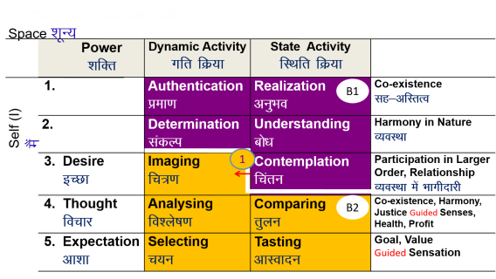
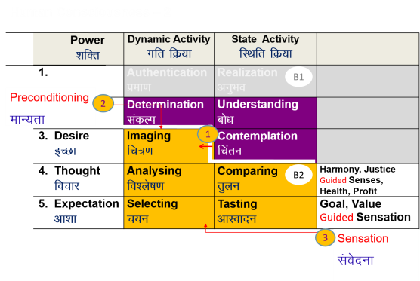
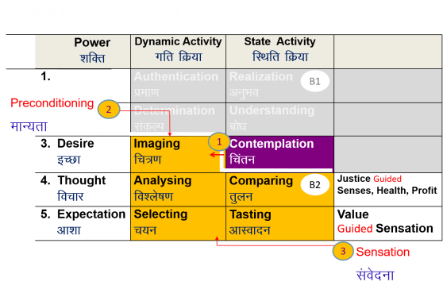
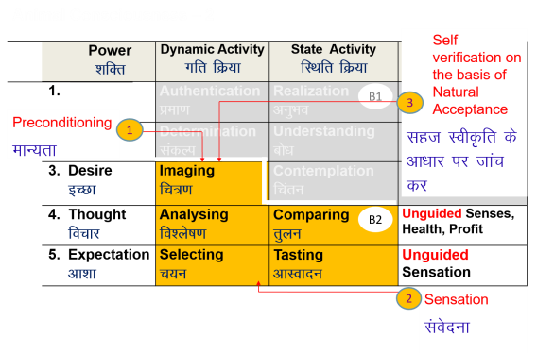
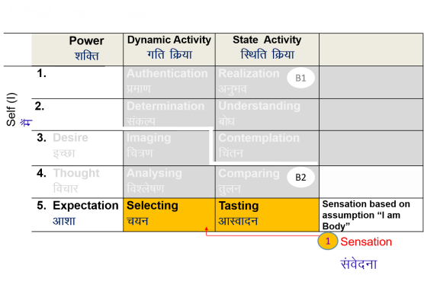
Self-evolution
Self-exploration
Self-verification
Human Consciousness
Living on the basis of knowing
Happiness by being in harmony within and harmony in all aspects of being
Acceptance of relationship – from one to many, to all [HAPPINESS]
Identifying need, production, right utilisation of physical facility [PROSPERITY]
Participation in larger order, expanding harmony [SOCIETAL DEVELOPMENT]
Transformation / Development
Living on the basis of assuming (without knowing)
Happiness from outside (through feeling from the other, sensual pleasure and physical facility)
Domination and opposition in relationship [UNHAPPINESS]
Exploitation and indulgence [DEPRIVATION]
Exploitation in larger order, increasing disorder [DEGRADING SOCIETY]
Animal Consciousness

Slide 61
Question(s): Harmony in the Self, Happiness Response
After the last tutorial session on self-awareness, my problems have increased! I was quite happy before. Now I can see many contradictions within… I cant even sleep properly. What to do?
When we start becoming aware of our self, we are able to see that there are contradictions within and therefore unhappiness within. This was there even before, but we were not aware of it. So it appears that our unhappiness has increased.
As a matter of fact, when we become aware of our self, our imagination, and our natural acceptance, than we are able to get rid of many contradictions that were there within and therefore there is a increase in our state of being in harmony and happiness within.

Slide 62
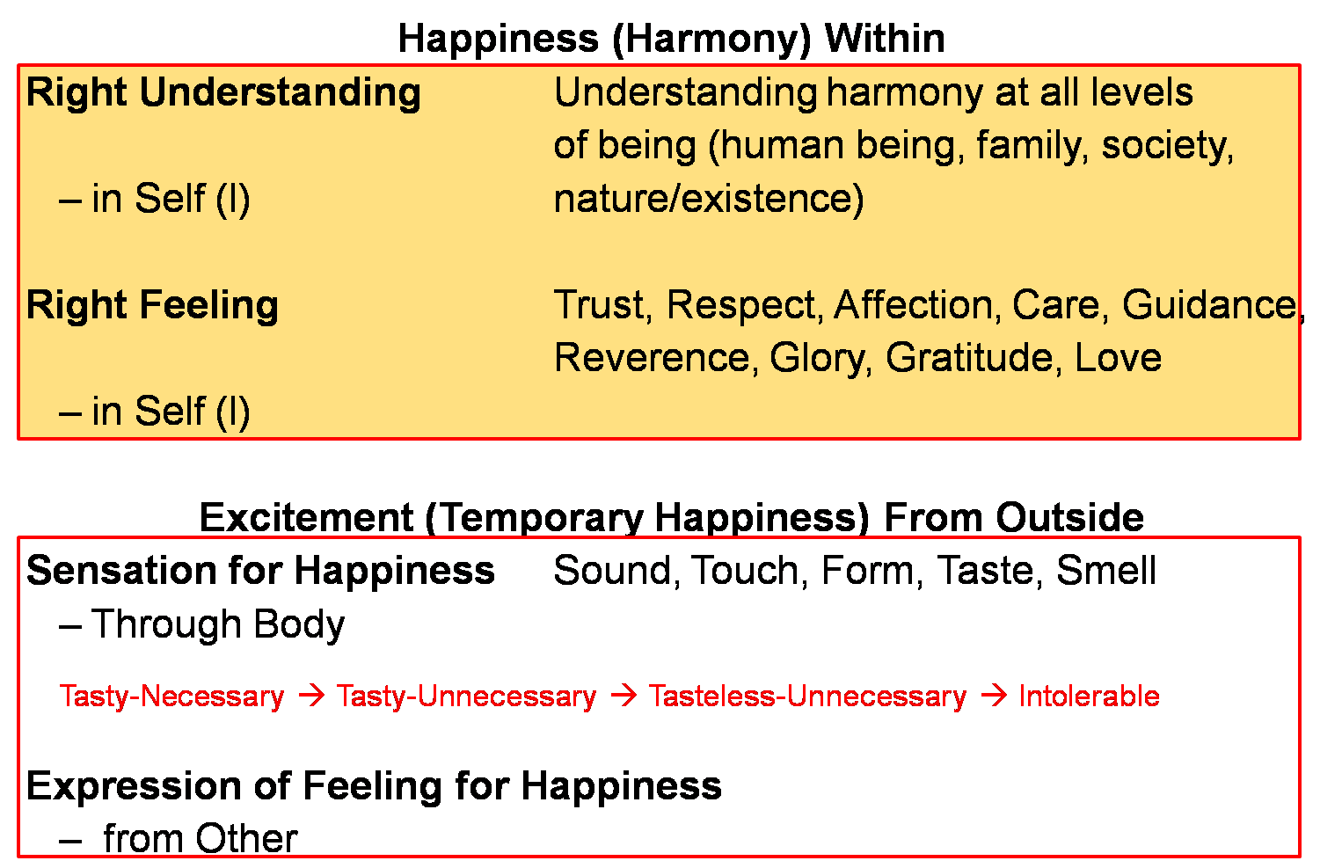
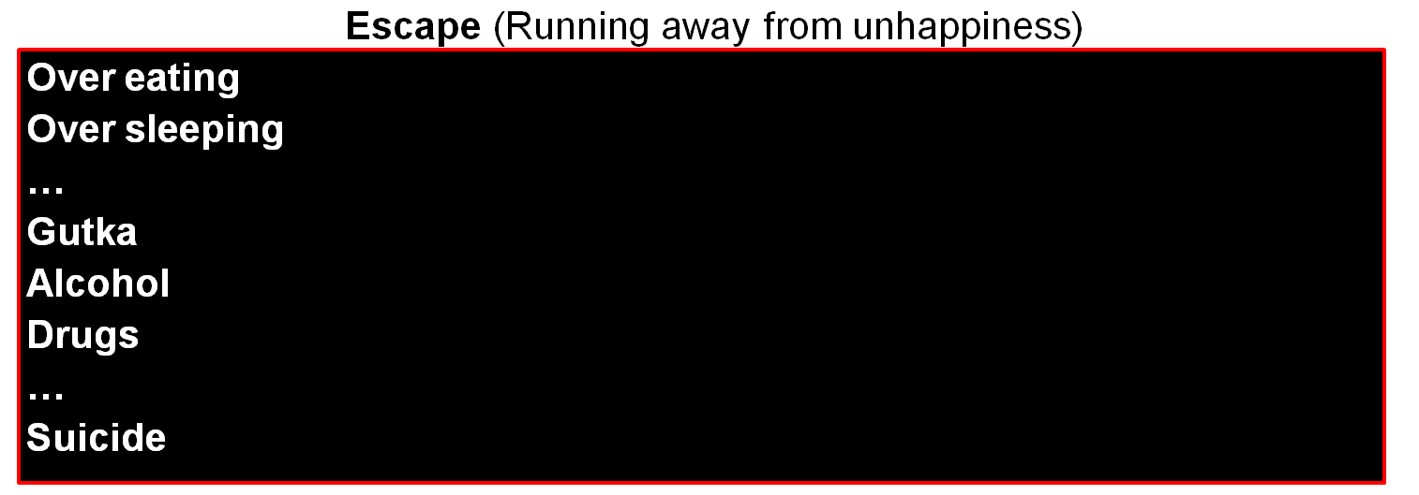
Continuous happiness
Realised
(Dorji)
Human Consciousness
--------------------------------------------------------------------- Transformation / Development -----------------------------------------
Temporary excitement
Recovering
Addict
Animal Consciousness
Temporary escape from unhappiness
Addict

Slide 63
Question(s): Harmony in the Self, Happiness Response
I can see that I can work within. But what about outside, with others. I have a desire to work also and to be with the family also. I want to fulfill both and feel that if any of those is not fulfilled, I will be unhappy. What is the way forward?
We have to understand the harmony in society and harmony in family & nature and then define a way of life, a system in the society, which ensures the fulfilment of all these harmony. Then we will be free of these contradictions.

Slide 64
Extra Qs.
6th sense
Intuition
Reflex action
Intellect
Cognitive ability
5 quotients
SQ Social quotient self+body+…
IQ Intelligence quotient self
EQ Emotional quotient self
SQ Spiritual quotient self
Split personality
Schizophrenia

Slide 65
Can you comment about Freud’s theory of motivation

Slide 66
Sanskar
To be placed in UHV-III

Slide 67
Sanskar
Sanskar = Acceptances derived out of ∑ [ Desire + Thought + Expectation ]
from all time
+ Acceptances born out of right understanding
Our acceptances include:
  Our preconditioning, our likes and dislikes…
  Conclusions drawn from life events / experiences, our “formulas” for living
  Understanding of the human reality, of the universal, invariant existential laws / principles
Our sanskar, our acceptances may or may not be in line with our natural acceptance
The preconditioning motivating our imagination (D, T, E) is largely coming from our own sanskar, which we have accumulated over all time
We may or may not be aware of it

Slide 68
Sanskar is Updated from Time to Time
Sanskar (t+1) = Sanskar (t) + Environment (t) + Self-exploration (t)
Sanskar at the next moment = sanskar at the present moment +
the environment available at the present moment +
self-exploration at the present moment
If the environment is conducive to self-exploration, and we are able to do the self-exploration sincerely, we are able to resolve our preconditionings and our sanskar is further purified
If the environment is not conducive to self-exploration, and we are unable to do self-exploration, we may accumulate more of the prevailing preconditioning, further worsening our sanskar
Self-exploration has to do with referring to our natural acceptance, developing right understanding and resolving, purifying our sanskar
Since the natural acceptance of every human being is pure (for harmony), every self has the potential for completeness of right understanding and complete purification of sanskar

Slide 69
Exercise
Evaluate your sanskar vis-à-vis your natural acceptance
Life is a struggle for survival
Survival of the fittest
The world is our family
Tit for tat
Int ka jawab patthar se (if someone throws a brick at you, reply with a stone)
Turn the other cheek
Money is everything
…

Slide 70
Exercise
Evaluate your sanskar vis-à-vis your natural acceptance
Life is a struggle for survival PC
Survival of the fittest PC
The world is our family NA
Tit for tat PC
Int ka jawab patthar se (if someone throws a brick at you, reply with a stone) PC
Turn the other cheek PC
Money is everything PC
…

Slide 71
Program of Action (Individual)
To understand harmony and to live in harmony
– at all levels of being (individual, family, society, nature/existence)
Self-exploration – Verify the proposals on your own right → right understanding (of harmony) → feeling and thought of harmony → harmonious behaviour, work and participation in larger order
Self-awareness – Be aware of your desire, thought and expectation – every moment
Self-evaluation – Evaluate your desire, thought and expectation
    – on the basis of your Natural Acceptance
What I Really Want to Be
My Natural Acceptance
My Intention
Discover
Guide
What I am
My Desire, Thought, Expectation…
My Competence
Purify

Slide 72
Program of Action (Individual)
To understand harmony and to live in harmony
– at all levels of being (individual, family, society, nature/existence)
Self-exploration – Verify the proposals on your own right → right understanding (of harmony) → feeling and thought of harmony → harmonious behaviour, work and participation in larger order
Self-awareness – Be aware of your desire, thought and expectation, sanskar – every moment
Self-evaluation – Evaluate your desire, thought and expectation and Sanskar
    – on the basis of your Natural Acceptance
What I Really Want to Be
My Natural Acceptance
My Intention
Discover
Guide
What I am
My Desire, Thought, Expectation, Sanskar
My Competence
Purify

Slide 73
Self Reflection

Slide 74
Key Points
Understanding Harmony in the Self

Slide 76
Human Being Ekkuo | Self eSa | Body “kjhj
Need vko';drk | Happiness (e.g. Respect) lq[k ¼tSls lEeku½ | Physical Facility (e.g. Food) lqfo/kk ¼tSls Hkkstu½
In Time dky esa | Continuous fujUrj | Temporary lkef;d
In Quantity ek=k esa | Qualitative (is Feeling) xq.kkRed ¼Hkko gS½ | Quantitative (Required in Limited Quantity) Ekk=kRed ¼lhfer ek=k esa½
Fulfilled By iwfrZ ds fy, | Right Understanding & Right Feeling lgh le>] lgh Hkko | Physio-chemical Things HkkSfrd&jklk;fud oLrq
Activity fØ;k | Desire, Thought, Expectation… bPNk] fopkj] vk”kk--- | Eating, Walking… [kkuk] pyuk---
In Time dky esa | Continuous fujUrj | Temporary lkef;d
Response | Knowing, Assuming, Recognising, Fulfilling tkuuk] ekuuk] igpkuuk] fuokZg djuk | Recognising, Fulfilling igpkuuk] fuokZg djuk
 | Consciousness pSrU; | Material tM+
Co-existence
lgvfLrRo

Slide 77
Activities of Self eSa dh fdz;k,a
 | Power “kfDr
1.
2.
3. | Desire bPNk
4. | Thought fopkj
5. | Expectation vk'kk
Activity fØz;k
Imaging fp=.k
Analysing-Comparing fo'ys"k.k&rqyu
Selecting-Tasting p;u&vkLoknu
Self eSa
Imagination
dYiuk”khyrk
Information
Body 'kjhj
Behaviour O;ogkj
Work dk;Z

Slide 78
Activities of Self eSa dh fdz;k,a
 | Power “kfDr
1.
2.
3. | Desire bPNk
4. | Thought fopkj
5. | Expectation vk'kk
Activity fØz;k
Imaging fp=.k
Analysing-Comparing fo'ys"k.k&rqyu
Selecting-Tasting p;u&vkLoknu
Meaning
What I want to be My feeling within
How to go about it How to ensure fulfillment of the feeling (its details)
What I have to do outside for expression of the feeling
Self eSa
Information
Body 'kjhj
Note: We explore these activities in detail in UHV-III

Slide 79
Sources of Motivation for our Imagination and its Implications
 | Power “kfDr
1.
2.
3. | Desire bPNk
4. | Thought fopkj
5. | Expectation vk'kk
Activity fØz;k
Imaging fp=.k
Analysing-Comparing fo'ys"k.k&rqyu
Selecting-Tasting p;u&vkLoknu
Self verification on the basis of Natural Acceptance
lgt Loh—fr ds vk/kkj ij tkap dj
Self eSa
3
Preconditioning
ekU;rk
Content of Imagination
dYiuk”khyrk
dh oLrq
Self-organised
Lora=rk √
1
Enslavement
ijra=rk X
Information
Body 'kjhj
2
Sensation
laosnuk
Behaviour O;ogkj
Work dk;Z
Enslavement ijra=rk X

Slide 80
State of Imagination – Random and Disorganised
 | Power “kfDr | Activity fØz;k
1. |  | Realization vuqHko
2. |  | Understanding cks/k
3. | Desire bPNk | Imaging fp=.k
4. | Thought fopkj | Analysing fo'ys"k.k
5. | Expectation vk'kk | Selecting/Tasting p;u@vkLoknu
Natural Acceptance
INTENTION
3
Preconditioning
ekU;rk
1
COMPETENCE
What You Are
Information
Body 'kjhj
2
Sensation
Lakosnuk
Behaviour O;ogkj
Work dk;Z

Slide 81
Harmony in Self = D, T, E in accordance with Natural Acceptance
 | Power “kfDr | Activity fØz;k
1. |  | Realization vuqHko
2. |  | Understanding cks/k
3. | Desire bPNk | Imaging fp=.k
4. | Thought fopkj | Analysing fo'ys"k.k
5. | Expectation vk'kk | Selecting/Tasting p;u@vkLoknu
Right Understanding to be ensured in the Self
Natural Acceptance
INTENTION
Guided
Content of imagination
COMPETENCE
What You Are
Guided by
Right Understanding
Information
Body 'kjhj
Behaviour O;ogkj
Work dk;Z
Happiness = To be in a state of Harmony
Lkq[k ¾ laxhr esa] O;oLFkk esa thuk

Slide 82
Sum Up
The Self is a unit of consciousness. It consists of various activities which are going on continuously
  The activities of desire, thought and expectation are together called imagination
  We can begin to observe the Self by becoming aware of our
    imagination and
    natural acceptance
  Behaviour and work are external expressions of imagination
Imagination may be motivated by preconditioning or sensation or natural acceptance
  When imagination is fully motivated by natural acceptance, the Self is in harmony; and therefore in a state of continuous happiness. This is the state of self-organization (स्वतंत्रता). In this state, the conduct is definite and human
  When the imagination is motivated by preconditioning or sensation, the Self may be in harmony or disharmony/contradiction; and thus in a state of happiness or unhappiness. This is a state of enslavement (परतंत्रता). In this state, the conduct is indefinite (it may be human or inhuman)

